Slide 1




August 22, 2014 Professional Development
with
“Your Host”
Dr. Jonathon A. Gould
Asst. Professor, Assessment Coordinator, & Fieldwork Coordinator
Saginaw Valley State University
College of Education – TEMS Dept.
Office EN 224
JAGould@SVSU.Edu (Email – the BEST way to contact me)
(989) 964-4981 (Office)
(989) 492-4077

Slide 2

Tent Cards
Please take a moment to fill-out the front of a Tent Card with the following information:
  First and Last Name (Nice and BIG)
  The Grade Level(s) you currently teach
  The Subject(s) you currently teach
  The City where you currently reside
Separate the back of the card into 4 quadrants

Slide 3
The Power of Modeling
“I would rather see a sermon,
than hear one, any day…”

Slide 4


Ice Breakers
  Pipe Cleaner Introductions
    Take a few minutes to get to know the person next to you (taking notes if needed).
    You will be asked to introduce this person to the class.
      Be sure to share their:
        First and Last Name
        Ideal Subject / Grade Level to teach
        City of Residence
        Family Information
        One thing she/he does for fun (or one secret, if they’re brave enough to share it)
        While listening, fashion a pipe cleaner into a shape which represents something your learned about her/him.

Slide 5
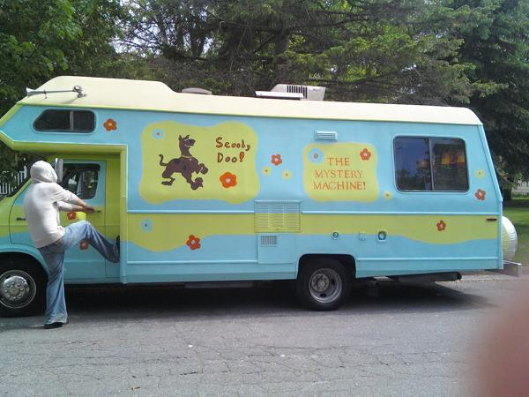
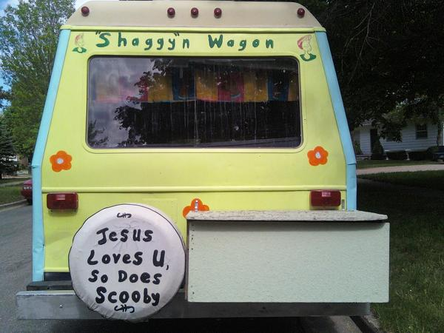
Dr. Jonathon A. Gould
My wife says it should read, “The Humiliation Station” instead of “Shaggy”n Wagon
I currently do consulting work all over the State of Michigan, and have been invited to Florida and Washington D.C. to share insights on Classroom Climate, Instructional Practices, Assessment, etc.
I taught for Midland/Bay City Public Schools for over a decade
  7th / 8th Graders: Basic Math, Pre-Algebra, Algebra, and Science
  9th & 10 Grade Algebra 1, Geometry (Gifted and Talented, Inclusion, ESL Students)
I currently live in Midland
I have 6 children, 1 Grandchild, 2 cats, 1 pug, and 1 wife – Cheri.
For fun we camped in our “Scooby Doo” RV (until those “meddling kids…”

Slide 6
Ice Breakers
  Pipe Cleaner Introductions
    Take a few minutes to get to know the person next to you (taking notes if needed).
    You will be asked to introduce this person to the class.
      Be sure to share their:
        First and Last Name
        Ideal Subject / Grade Level to teach
        City of Residence
        Family Information
        One thing she/he does for fun (or one secret, if they’re brave enough to share it)
        While listening, fashion a pipe cleaner into a shape which represents something your learned about her/him.

Slide 7

Ice Breakers (Continued)
  Communication is 80% Visual
  Genetics
  Bean Bags for Gags
    Arrange yourselves in a circle, alphabetically by FIRST Name

Slide 8

Differentiated Instruction
  Please take 2 minutes to quietly write what you currently Know and Wonder/Want-to-know about Differentiated Instruction next to the K and W on the KWLS Chart.
  Save the L and S for later in our session.
  Small-to-Large Group Discussion to follow ☺

Slide 9
KWLS Chart – Differentiated Instruction
Know
Wonder
Learned
Still want to know

Slide 10


Quick-Write Question(s):
Heavy-Weight Champion of the world, Mike Tyson, once said, “Everyone has a plan, until they get hit!!!”
  How do his words lend themselves to the power of a properly written lesson plan?

Slide 11

Lesson Planning:
Overview of the
“15-Component Lesson Plan”

Slide 12
15-Component Lesson Plan
Grade Level/Name of Class/Content Focus/Content Stands. & Bench. (GLCEs & HSCEs)
Purpose/ Relevancy to Students
Special Needs Considerations/Accommodations
Resources
Performance Objective ABCD (Learning Outcome)
Content-Literacy Strategy
“Bell-Work”
Opening / Anticipatory Set
Instructional Method
Guided Practice
Lesson Closure
Formative Assessment(s)
Re-teaching Plan / Independent Practice / Extension Activity
Summative-Assessment(s)
Reflection Notes
“Behind the scenes” work
___ Minutes
___ Minutes
___ Minutes
Add Formative-Assessment Questions
___ Minutes
Add Formative-Assessment Questions
___ Minutes
More “Behind the scenes” work

Slide 13
1. Grade Level / Name of Class / Content Focus / Content Standards& Benchmarks (GLCEs / HSCEs & CCSSs)
The first thing to consider is what you want to teach. This should be developed based upon the Michigan Department of Education Content Standards and Benchmarks (Grade Level Content Expectations “GLCEs” / High School Content Expectations “HSCEs”) or in some cases the professional standards created by your discipline. The Common Core State Standards (CCSS) are currently developed for Mathematics and ELA, with Science, Social Studies, and Exploratory/Elective Classes “on their way.” Please see the next slide for links to the Michigan Department of Education (MDE) and the CCSS.
You also need to be aware of the grade level and name of the class you are developing the lesson for and the time you have to implement the lesson.
Once you have your content focus, you can begin determining how you want to teach the topic. Having your lesson plan correctly aligned with state standards helps to prove its worthiness and necessity. It also helps in assuring that your students are being taught what your state requires.

Slide 14


Link to the MDE & the CCSS
www.michigan.gov/glce
http://www.michigan.gov/mde/0,1607,7-140-6530_30334_51042-232021--,00.html

Slide 15
2. Purpose/ Relevancy to Students
The purpose of the lesson/relevancy to students connects the content to the students’ prior knowledge and makes a case for how this content is useful in the “real world”.
Embraces cultural diversity, equity, and sets high expectations for students.

Slide 16
3. Special Needs Considerations/Accommodations
Special needs considerations are adaptations which should be made for students with learning disabilities and extensions for others.
This is best done with general adaptations for the class, until the needs of specific students are identified.
Do NOT make general statements, such as “I will consult with the case manager or special education teacher”
  Have adaptations listed which will benefit the majority, and then add specific accommodations as the year progresses.
The use of Gardner’s Multiple Intelligences, Bloom’s Taxonomy, and Kagan’s Cooperative Learning strategies will complement the learning of ALL students, but can be described here.

Slide 17
4. Resources
Describe the resources needed to complete the lesson.

Slide 18
5.) Performance Objective ABCD (Learning Outcome)
To make sure your lesson plan will teach exactly what you want it to, develop a clear and specific performance objective.
Please note that objectives should not be activities that will be used in the lesson plan.
  Instead, the learning outcomes of those activities should be written in the ABCD format.
  A=Audience B=Behavior C=Conditions D=Degree of Mastery

Slide 19
6.) Content-Literacy Strategy
List the content-literacy strategy your students will be using during the lesson.
The content-literacy strategy is an activity to promote/enhance the use of writing and/or reading for this lesson.
A variety of strategies will be learned in TEMS 312, a few will be provided/discussed in TEMS 302.

Slide 20
7.) “Bell-Work”
Describe the “bell work” activities your students will be engaged in, during the 5-minute passing time between classes, and the first minute or two of class, while you are attending to attendance, etc.
___ Minutes

Slide 21
8.) Opening / Anticipatory Set
You will also want to write an opener or anticipatory set, which would be a way to lead into the lesson plan and develop the students' interest in learning what is about to be taught.
This is also an effective vehicle to access prior knowledge your students possess.
If the anticipatory set is a question/statement made by the teacher, place the statement in “bold-italics” to set it apart from the rest of the lesson plan.
___ Minutes

Slide 22
Anticipatory Sets – A few “electronic” examples:
Math
  “Bad Date” – Insight into ‘Ratios’ (fun for all ages!)
  http://mathsnacks.com/badDate.html
Social Studies
  School House Rock – “The Constitution”
  http://www.youtube.com/watch?v=30OyU4O80i4&feature=related

Slide 23
Anticipatory Sets – A few more “online” examples:
Language Arts
  Grammar Rock – “Adjectives”
  http://www.youtube.com/watch?v=4qUd2KHv7Ec
Exploratory Classes
  Physical Education – “Hungry-Hungry Hippo Game”
  http://www.youtube.com/watch?v=3SWMZ9ajTQg
Science
  “The Cell is like a City” – Parts of the cell w/ music!
  http://www.youtube.com/watch?v=qqCzGpXtq3I&feature=channel

Slide 24
9.) Instructional Method
Now you need to write your instructional method – the step-by-step procedures that will be performed to reach the objectives.
These don't have to involve every little thing the teacher will say and do, but they should list the relevant actions the teacher needs to perform.
___ Minutes

Slide 25
10.) Guided Practice
After instruction has been completed, you will want to provide time for guided practice.
This is where you assist the student as they safely practice to master the content, within the confines of the classroom walls.
___ Minutes

Slide 26
11.) Lesson Closure
Just before moving on to the assessment phase you should have some sort of lesson closure for the lesson plan.
This can be the answer to the “opening” question or the completion of a content-literacy strategy.
___ Minutes

Slide 27
12.) Formative-Assessment Strategies
→ Added throughout the lesson
Checking For Understanding
  The teacher uses a variety of formative-assessment strategies (questioning, etc.) to determine if students understand the content being taught. Quizzes are typically formative too.

Slide 28
13.) Re-teaching Plan / Independent Practice / Extension Activity
You will also want to have a re-teaching plan in the event that the majority of the students did not master the content.
Include a plan for independent practice in the event that a significant number of the students did not master the content.
Provide a plan for an extension activity in the event a group of students mastered the content and need to be challenged.

Slide 29

14.) Summative Assessment(s)
Now you want to write your summative assessment(s).
End-of Unit and End-of-Week Assessments prepare students for what is waiting for them:
  Standardized Tests (MEAP, MME, ACT, SAT, etc.)
    These assessments open or close doors for students!!!

Slide 30
15.) Reflection Notes
It's also a good idea to include a "reflection notes" section (to be completed after the lesson is presented), to develop the habit of evaluating the strengths and weaknesses of your lesson.
Address the major components of the lesson plan, focusing on both the strengths, and areas of needed improvement. Determine here how you plan to collect information that will be useful for planning future lessons.
A good idea is to analyze the difference between what you wanted (the objective) and what was attained (the results of the assessment).
Reflection Notes provide insight into what made the lesson powerful, and what will make it more meaningful for students in the future.
The most growth occurs here – impossible to do on an “unwritten” plan. ☺

Slide 31

The Road to creating
“The Perfect Lesson Plan”

Slide 32

Components 1 – 5
Class/Grade/Focus/GLCE (or HSCE or Strand/Standard/Benchmark)
Purpose/Relevance (provide all three sentence stems)
  “Students will learn about…”
  “Students will benefit from this because…”
  “Students will want to learn this because…”
Special Needs Considerations (Accommodations)
  Are students with cognitive needs addressed?
  Are students with psychomotor needs addressed?
Resources
  Are all resources listed “in print” (worksheets, etc.) provided with plan (as attachments)?
Performance Objective – ABCD format (label after each part)

Slide 33

Components 6 – 10
6. Content Literacy Strategy
Is a strategy listed “and” described?
7. Bell Work
Are instructions listed and described?
Can students do these with little/no assistance from teacher?
Opening/Anticipatory Set
Does this focus attention “and” pique student interest?
9. Instructional Method
Are “Multiple” steps (bullet points) listed?
Are the teacher’s actions described?
Are the students’ actions described?
Guided Practice
Are “Multiple” steps (bullet points) listed?
Are the teacher’s actions described?
Are the students’ actions described?
___ Minutes
___ Minutes
___ Minutes
Are any “worksheets or handouts” needed?
Are they provided as attachments?
___ Minutes

Slide 34


Components 11 – 15
11. Lesson Closure
Did you “land” your lesson?
Are students included in the “conversation?”
12. Formative Assessment
Do you ask questions at multiple times during lesson?
Are times/frequency stated? Quizzes Included?
13. Re-Teaching Plan
Is a plan provided in which you teach “differently”
Independent Practice
Are students’ (teacher’s) actions described?
Could a “Substitute/Guest Teacher” understand exactly what students will be doing?
Extension Activity
Is a plan provided for the extension and/or transfer of knowledge?
Summative Assessments
Is learning made visible/tangible?
15. Reflection Notes
___ Minutes

Slide 35

Lesson Planning – Final Question:
Can a Substitute/Guest Teacher pick up your plan, and complete it with 30 students, without assistance (other than directions to the copier and/or “supply room” (for scientific equipment, art supplies, maps/globes, calculators, etc.) from anyone?

Slide 36
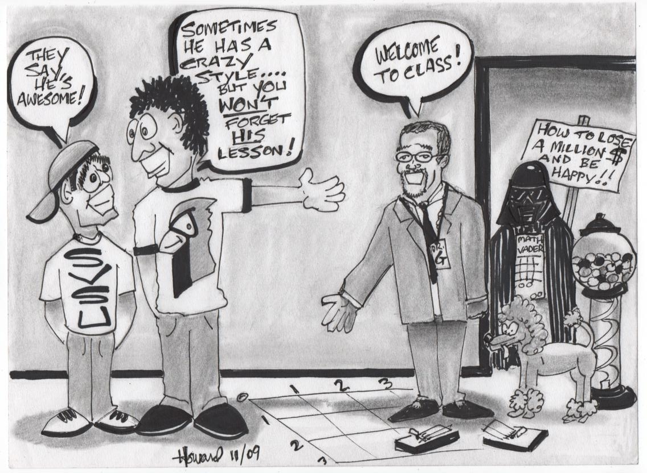
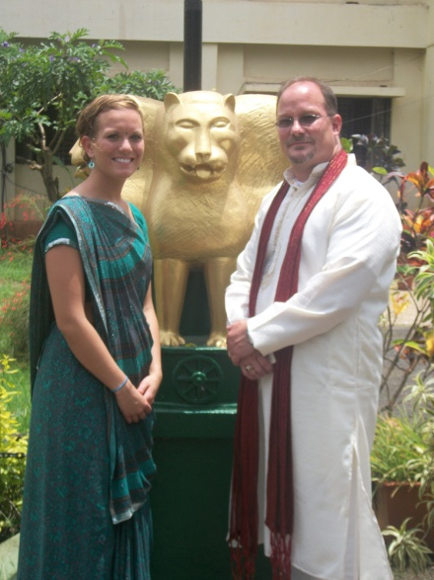
An Effective Lesson Plan Includes:
Integration of Content Literacy Strategies into Core and Explore/Elective Classes
Behaviorist and Constructivist in nature
Embraces Bloom’s Taxonomies
Utilizes Gardner’s Multiple Intelligences
Employs Kagan’s Cooperative Learning Strategies

Slide 37
Oil Tank Problem

Slide 38


Please take a minute to quietly think about the ways in which solutions to mathematics problems may be showcased:
  Arithmetically
  Geometrically
  Algebraically
  Adjective-Noun Theme
  Contextual Methods
  Manipulatives
After one minute of reflection has passed, take 2-3 minutes to talk with the people at your table about definitions and examples to the terms above
Whole Class discussion to follow ☺
G

Slide 39


Problem…
An oil tank must be cleaned before it can be moved to it’s new location on the edge of Lake Pontchartrain.
Each cleaning of the tank will reduce the contamination to half of what it was at the start of the cleaning.
The tank originally contains five barrels of contaminants. Use at least two different methods of solution.
How much contamination is present after four cleanings?
How many times must the tank be cleaned before the contamination is less than .01 barrel?
J

Slide 40
Problem…
An oil tank must be cleaned before it can be moved to it’s new location on the edge of Lake Pontchartrain.
Each cleaning of the tank will reduce the contamination to half of what it was at the start of the cleaning.
The tank originally contains five barrels of contaminants. Use at least two different methods of solution.
How much contamination is present after four cleanings?
Let’s complete the first problem together, using the large-chart paper to brainstorm different ways to showcase our solutions.
J

Slide 41

Problem…
An oil tank must be cleaned before it can be moved to it’s new location on the edge of Lake Pontchartrain.
Each cleaning of the tank will reduce the contamination to half of what it was at the start of the cleaning.
The tank originally contains five barrels of contaminants. Use at least two different methods of solution.
How much contamination is present after four cleanings?
How many times must the tank be cleaned before the contamination is less than .01 barrel?
Please work for 10 minutes with the people at your table to showcase multiple methods to solve and showcase your solution to Question 2 below ☺
G

Slide 42
KWLS Chart – Differentiated Instruction
Know
Wonder
Learned
Still want to know

Slide 43
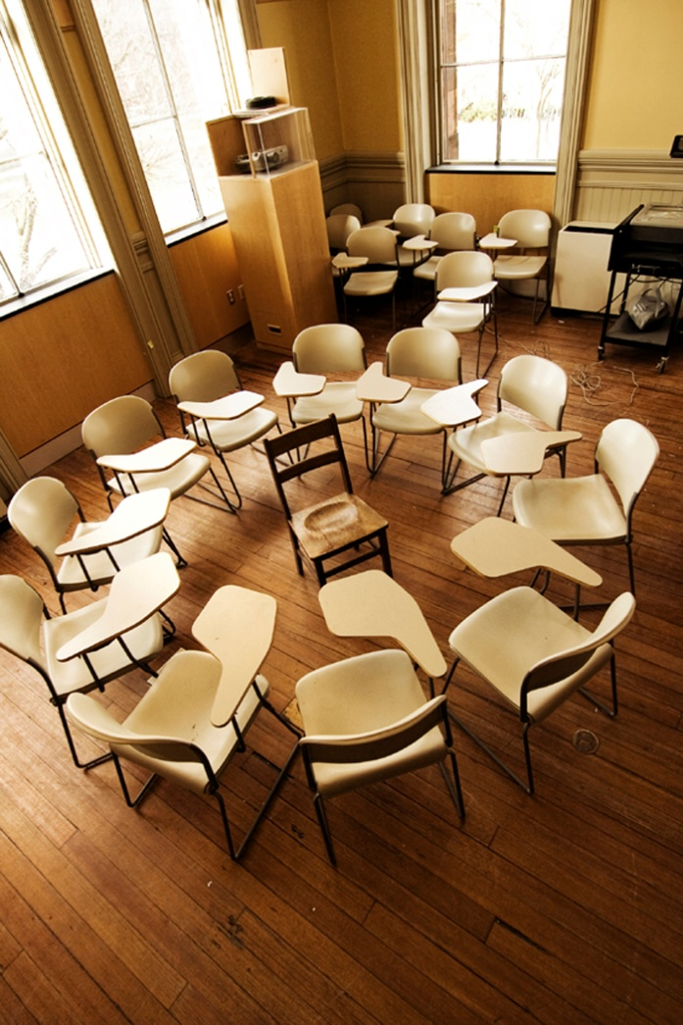


Classroom Climate:
Your “Ideal Classroom”

Slide 44
Window
V I d e o P r o j e c t I o n S c r e e n
Window
Library
Library
D
E
Bd
D
E
Bd
Seats 21-24
Seats 13-16 / 29-30
(or 33-34)
Seats 5-8 / 29-30
Video
Proj
Screen
Video
Proj
Screen
Ideal Classroom by
Dr. Jonathon A. Gould
Seats 17-20
Seats 9-12 / 31-32
(or 35-36)
Seats 1-4 / 31-32
Seats 25-28
Game Tables
(or Seats 37-40)
Door
D r y E r a s e / S m a r t B o a r d
Calculator Mat
Door

Slide 45
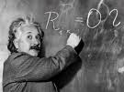
  Quick-Talk Pedagogical Question:
  “One definition of insanity is doing the same thing, the same way, but expecting different results!”
  --Albert Einstein
  Question:
  What are the pitfalls of teaching mathematics using only symbols?

Slide 46

Did you know…
Twenty-five divided by five equals fourteen?
http://www.youtube.com/watch?v=omyUncKI7oU&feature=related

Slide 47
The 6 Ways of Teaching & Learning
Symbolic
(Visual – Abstract)
Written Words (Visual)
Spoken Words
(Verbal)
Pictures
(Visual – Concrete)
Hands-On Activities
(Kinesthetic)
Real-World / Global Examples
(Life)
Dr. Jonathon A. Gould
Saginaw Valley State University
College of Education

Slide 48

Symbolic (Visual – Abstract)
Symbols are used in many classrooms.
Symbols are fast to write, but require an abstract thought pattern.
One of six ways to teach and/or assess student understanding.
Symbolic
(Visual – Abstract)

Slide 49

Written Words (Visual)
Written words begin to remove the abstract thought processes.
Language is one of Gardner’s Multiple Intelligences (Word Smart).
One of six ways to teach and/or assess student understanding.
Written Words (Visual)

Slide 50

Spoken Words (Verbal)
Spoken words also help to remove the abstract thought processes.
Interpersonal communication is one of Gardner’s Multiple Intelligences (People Smart).
One of six ways to teach and/or assess student understanding.
Spoken Words
(Verbal)

Slide 51

Pictures (Visual – Concrete)
Pictures help remove the abstract thought processes, and make them concrete.
Pictures are one of Gardner’s Multiple Intelligences (Art/Spacial Smart).
One of six ways to teach and/or assess student understanding.
Pictures
(Visual – Concrete)

Slide 52

Hands-On Activities (Kinesthetic)
Hands-On and/or “Out of Your Seat” activities remove the abstract thought processes, and make learning both concrete and fun!!!
Movement complements one of Gardner’s Multiple Intelligences (Body Smart).
One of six ways to teach and/or assess student understanding.
Hands-On Activities
(Kinesthetic)

Slide 53
Real-World / Global Activities (Life)
Real-World / Global activities make learning applicable for students.
Assigns value to comprehension.
Engages a collection of Gardner’s Multiple Intelligences (Word, Math, Art, Body, Self, People, Nature, Music, … Smart).
One of six ways to teach and/or assess student understanding.
Real-World / Global Examples
(Life)

Slide 54
Let’s do a few examples together, surrounding the concept fractions ☺

Slide 55

1/2 x 1/3 = ?
1/2 + 1/3 = ?
1/2 – 1/3 = ?
1/2 – 1/3 = ?
How would
you teach
these basic
skills in
Mathematics?

Slide 56
This is “One Whole”

Slide 57
This is “One Half”

Slide 58
This is “One Third of One Half”

Slide 59
One
Sixth
One Third of One Half is One Sixth
1/3 x 1/2 = 1/6

Slide 60

The Six Ways of Teaching & Learning (cont.)
We’ve seen symbols turned into written words,
We’ve spoken differently than we write
We’ve embraced pictures
Now let’s get some movement going… ☺
  12 people need to stand-up

Slide 61

Real-World / Global Activities (Life)
Real-World / Global Examples
(Life)
Real-World / Global activities make learning applicable for students.
Assigns value to comprehension.
Engages a collection of Gardner’s Multiple Intelligences (Word, Math, Art, Body, Self, People, Nature, Music, … Smart).
One of six ways to teach and/or assess student understanding.
This past summer I want to spend my time equally between three areas in my life:
Family Time
Academia
Reading for Fun
If I have 90 days of summer, and I want to read two books (equal in length) for fun, how many days of reading will I have for each book?

Slide 62
This is “One Half”
This is
“One Third”

Slide 63
This is “Three Sixths”
This is
“Two Sixths”

Slide 64
“Two Sixths”
“Three Sixths”
Three Sixths plus Two Sixths is Five Sixths
1/2 + 1/3 = ???
3/6 + 2/6 = 5/6

Slide 65
“Three Sixths”
Three Sixths “take-away” Two Sixths is One Sixth
1/2 - 1/3 = ???
3/6 - 2/6 = 1/6

Slide 66
Is anyone struggling with how to “Model” 1/2 divided by 1/3?
Let’s start with an easier “Division Problem,” such as Six divided by two equals ???
  This is usually shown like this:
    6 divided by 2 equals 3
But, try to think of this as Six “divided into piles of” two, like this:
Now, how many Two” (yellows) are shaded?
“Piles of
→ Three! ☺

Slide 67
Re-Cap…
This represents one whole:
And so does this:
But this represents only one-half of a whole (notice only ½ is shaded in blue):
And this represents only one-fourth of a whole (notice only ¼ is shaded):

Slide 68
Now let’s model an easier “fraction divided by a fraction” example:
Let’s start with an easier one to model – How about ½ divided by ¼
  This is usually shown like this:
    1/2 divided by 1/4 equals 1/2 times 4/1 = 4/2 = 2
But, try to think of it as ½ “divided into piles of” ¼, like this:
Now, how many ¼’s (yellow) are shaded?
→ Two! ☺

Slide 69
1/2 divided by 1/3 equals
Remember, think of this as
1/2 “divided into piles of” 1/3

Slide 70
1/2 divided by 1/3 equals 1/2 times 3/1, which equals 3/2, which equals 1 ½
Now, how many 1/3’s (yellow) are shaded?
– You got it → One and a half!!! ☺

Slide 71
Real-World / Global Activities (Life)
Real-World / Global Examples
(Life)
Real-World / Global activities make learning applicable for students.
Assigns value to comprehension.
Engages a collection of Gardner’s Multiple Intelligences (Word, Math, Art, Body, Self, People, Nature, Music, … Smart).
One of six ways to teach and/or assess student understanding.
Think about how chocolate bars, graham crackers, and other objects can be used to model mathematics!

Slide 72

Improper Fractions Modeled

Slide 73
The Frayer Model
Please label quadrants on the back of your tent-card in this order:
  Upper-Left → Definition
  Upper-Right→ Examples
  Lower Left → Non-Examples
  Lower Right → Applications to the outside world (or Drawing – Your Choice ☺ )
  In the circle, write the words “Differentiated Instruction”

Slide 74
KWLS Chart – Differentiated Instruction
Know
Wonder
Learned
Still want to know

Slide 75

Dr. Jonathon A. Gould → JAGould@SVSU.Edu
I wish to thank each and every one of you, for YOU are the reason this Professional Development was both magical and meaningful! I wish you success this school year ☺

Slide 76
Extras – Time Permitting

Slide 77
  Base Five
Base five contains the numerals (0, 1, 2, 3, 4), just as base ten contains the numerals (0, 1, 2, 3, 4, 5, 6, 7, 8, 9)
    Let’s Count to 15 in Base Five
    Problems:
    Write the first 25 counting numbers in base five.
    Write the following base five numbers in base ten
      213₅
      1000₅
      21432₅
    Write the following base ten numbers in base five:
      46
      319
      1000

Slide 78
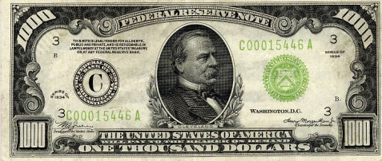
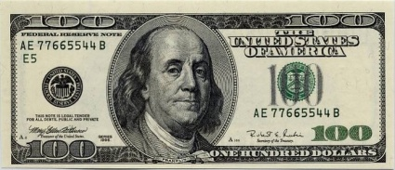
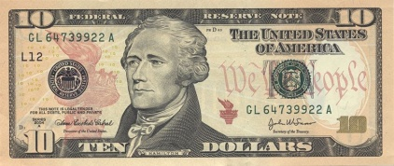
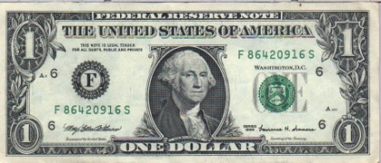
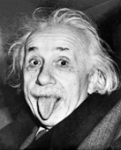
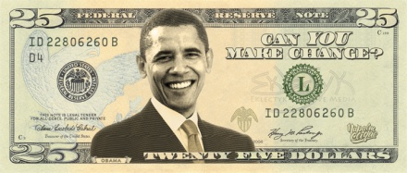
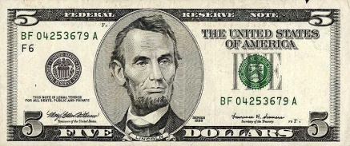
Base Ten
4 0 3 2
$517
Base Five
4 0 3 2 ₅
125
125
125
125
What would be the next “denomination-of-bill” in Base Five?

Slide 79












Quick-Write Question(s):
What is a “Discipline Problem?”
  Share your thoughts with the people at your table

Slide 80
A Discipline Problem:
A Discipline Problem is behavior that:
  1. Interferes with the teaching act
  2. Interferes with the rights of others to learn
  3. Is physically or psychologically unsafe
  4. Destroys property (School/Others/Self)

Slide 81

Please share a Classroom Management Scenario you’ve witnessed with the people in your group
What could you do to be Pro-Active in this situation?
Explain what you would do to engage this student, and not loose the “FLOW” of your lesson.
15

Slide 82

Classroom Management 101
Say what you Mean
and
Mean what you say!!!

Slide 83
Classroom Management Plan
Step One: Eye Contact (Give “The Look”)
Step Two: Use Physical Proximity (stand near student’s desk)
Step Three: State Student’s Name (use firm / friendly tone)
Step Four: Have the “Fireside Chat” (quiet chat at student’s desk)
Step Five: Ask student to move from her/his seat to the “Good Student who’s Having a Bad Day Chair”
Step Six: Ask student to fill-out the “What am I doing Wrong Form”
Step Seven: “Parental Chat” (quick call home)
Step Eight: “Counselor Chat” (time to find out issues)
Step Nine: “Principal Time” (time for needed consequences)
Document all of this from this point on.

Slide 84
What’s the difference between Rules and Procedures?
(Group Discussion Time)

Slide 85

Classroom Rules
Simply put, rules say what you may or may not do.

Slide 86

Classroom Procedures
Procedures teach us how to do something

Slide 87
Sample Classroom Rules
You may not be disrespectful in this classroom
You may have fun and learn ☺
You may not chew gum in this classroom
You may enjoy a gobstopper or some skittles!!!

Slide 88

Sample Classroom Procedures
Enter the room quietly, on-time, and ready
Raise your hand and WAIT to be called upon
Do not leave your seat without permission
Always be respectful to everything, at all times

Slide 89


How do you define the illegal concept of Corporal Punishment?

Slide 90
Corporal punishment refers to intentional application of physical pain as a method of changing behavior. It includes a wide variety of methods such as hitting, slapping, punching, kicking, pinching, shaking, choking, use of various objects (wooden paddles, belts, sticks, pins, or others), painful body postures, use of electric shock, use of excessive exercise drills, or prevention of urine or stool elimination.
A major obstacle to establishing a universal ban on corporal punishment is the current popular opinion in the United States that it is legally permissible to apply physical punishment to children in school. The common law since before the American Revolution has provided that, although teachers may use reasonable force to protect self, other students, or school property, any excessive or unreasonable force will subject the educator to either criminal liability or a civil claim for personal injuries.
Levin, J., & Nolan, J. F. (2007). Principles of classroom management: A professional decision-making model (5th Edition).
Boston: Pearson Education, Inc.

Slide 91






Teaching Collaboration & Cooperative Learning Using
“The Six Thinking Hats” by
Edward DeBono

Slide 92
Overview of the Six Hats
The Green Hat
  Green Like vegetation and new growth
The White Hat
  Neutral color – “Just the facts mam”
The Yellow Hat
  Yellow like an optimistic sunny day
The Black Hat
  The “Devil’s Advocate” to emphasize the negative
The Red Hat
  Red like the human heart – full of emotion
The Blue Hat
  Blue like the sky above – the CEO to maintain order

Slide 93

You have just entered a government “Think Tank.”
Take a moment to ponder new ideas waiting to be researched and explored.

Slide 94

“The Scenario”
After months collecting a paycheck in research and development, you have a question that you would like to propose to the group.
You put on your White Hat, gather data, and put together an unbiased, informational presentation about ice cream, for the group.
“What Flavor of ice cream is superior, chocolate or vanilla?”

Slide 95



The White Hat
“Just the facts, mam”
Chocolate Ice Cream:
  The botanical name for cocoa is "Theobroma Cacoa,“ and is made from the beans--grown mainly in Central America
  Amount consumed by the average person in the United States 48 Pints per year
Vanilla Ice Cream
  Comes from plant “Vanilla Planifolia” - a member of the orchid family--grown mainly in Madagascar
  Amount consumed by the average person in the United States 48 pints per year

Slide 96

The Yellow Hat
At this time, put on your “Yellow Hat” (yellow like the sun) – only “Sunny,” positive comments from the group are allowed.
Let’s discuss all of the potentially positive outcomes of choosing chocolate over vanilla.

Slide 97

The Yellow Hat (Continued)
Keeping your “Yellow Hat” on, let’s discuss the potentially positive outcomes of choosing vanilla over chocolate.

Slide 98

The Black Hat
Now let’s put on our “Black Hat” (remember, black like the devil).
Let’s discuss the potentially negative outcomes of choosing chocolate over vanilla.
Let’s discuss the potentially negative outcomes of choosing vanilla over chocolate.

Slide 99

The Red Hat
It’s time to “Get in touch with our emotions.”
Please put on your “Red Hat” (red, like your heart -- the “Emotional Hat”) and we will discuss how we are feeling about choosing one ice cream over another.

Slide 100


The Blue Hat
The Blue Hat (blue, like the sky above – the “CEO Hat”) can be worn by any member of the group, at any time.
Often, one member of the group wears this hat, and tactfully reminds other group members of the current hat the members are to be wearing.

Slide 101

Extensions
Fist-to-Five
Consensus
Debate
Voting
Three-Legged “Race”

Slide 102
References
DeBono, E. (1995). The six thinking hats. Boston: Back Bay Books.
Gunter, M. A., Estes, T. H., & Mintz, S. L. (2007). Instruction: A models approach. Boston: Pearson Education, Inc.

Slide 103




“The Six-Hat Rap”
O’ when I’m wearin’ the Green Hat,
Ideas I grow,
I’m always on the lookout,
For new things, you know?
Just part of my posse,
Just part of the pack,
I sometimes where the white hat,
Cause ya need all da facts.
But when I’m wearin’ the yellow,
Good things I embrace,
So please stop your b*#&@in’,
Ya need to know your place
And now it’s time for your turn, Black,
You know you’re the one,
Always bein’ so careful,
Always ruin all the fun.
But when I put on da red hat,
I’m hot just like a lighter,
You know I luv da feelins’,
I’m a lover not fighter!
And now remember the blue,
The one who rules the pack,
Keepin’ all us in line,
And I hope you liked the hats.
“Word”
“WiKI
wIKI”
“Boooy”

Slide 104





Blue Hat
Green Hat
White Hat
Yellow Hat
Black Hat
Red Hat

Slide 105

Teaching Collaboration & Cooperative Learning Using
“The Six Thinking Hats”
by
Edward DeBono

Slide 106

“The Cast”
Will Work
for Tenure
“The New Guy”
(Will do anything
to keep his job)
“Happy to
Help-Out”
(Believes in Collaboration)
“Fearless Leader”
(Principal of Building)
“Treadin’ Water ‘til
Retirement”
(Only 17 Years to Go,
Then I’m Outta-Here!)
“Social Problem”
(Too Much Partying –
Will try to pass it off as being ‘Sleepy’)
“Sick with Love”
(Just not Feeling
Well Today)

Slide 107
Welcome Staff!
I wanted to take a moment to share an idea I had while I was brainstorming this morning, during a meeting at the School “Bored” Building.
What do you think about the idea of requiring School Uniforms for our Students?
Will Work
for Tenure

Slide 108
Before we begin to share our
ideas, let’s try using the 6 Thinking Hats to explore this idea completely.
We’ll start-out by wearing our White Hats (sharing only facts we find), then we’ll wear our Yellow Hats (to share some of the good things about school uniforms, then we’ll put-on our Black Hats (to share some of the bad things/concerns), and then we’ll put-on our Red Hats (to establish how we feel, before we vote on this).
Will Work
for Tenure

Slide 109
Rubric for a Book Chapter Presentation
What’s wrong with this Rubric???
Component | 1 Point | 2 Points | 3 Points
Knowledge of Chapter’s Content | Group demonstrated weak content knowledge about Chapter’s Content | Group demonstrated some content knowledge about Chapter’s Content | Group demonstrated strong content knowledge about Chapter’s Content
Presentation “Energy/Enthusiasm” | Z Z Z Z Z Z Z Z … | Group members taught the chapter’s content in an acceptable manner | Group members “brought the chapter to life” – highly kept my attention
Public Speaking Abilities | Group Members had little to no public speaking abilities | Group Members had some public speaking abilities | Group Members had strong public speaking abilities

Slide 110
Rubric for a Book Chapter Presentation
Component | Unacceptable | Acceptable | Target
Knowledge of Chapter’s Content | Group demonstrated 1-2 components of chapter’s content (1 Point) | Group demonstrated 3-4 components of chapter’s content (2 points) | Group demonstrated 5 or more components of chapter’s content (4 Points)
Presentation “Energy/Enthusiasm” | Group demonstrated presentation energy/enthusiasm at a novice level (1 Points) | Group demonstrated presentation energy/enthusiasm at an intermediate level (2 Points) | Group demonstrated presentation energy/enthusiasm at an advanced level (3 Points)
Public Speaking (Voice Projection, Movement, Eye Contact) | Group Members had 1 of the following 3: strong voice projection, good movement, made eye contact (1 Point) | Group Members had 2 of the following 3: strong voice projection, good movement, made eye contact (2 Points) | Group Members had strong voice projection, good movement, and made eye contact (3 Points)

Slide 111
Quick-Write Question(s):
What is your “Biggest Strength/Fear” about teaching?
How does an understanding of your students’ needs complement your strengths and address some of your fears?
How will you organize your lesson plans to address both the quality needed to teach effectively and the quantity required through your school district’s scope and sequence?
When is the “Best” time to introduce new information, during a lesson? Provide a rationale statement for this.

Slide 112

The Brain-Compatible Learning Model:
The First 20 Min.
The Last 20 Min.
The Next 20 Min.
Sadker, D. S., & Zittleman, K. R. (2009). Teachers, schools, and society: A brief introduction into education.
2nd Edition. New York: McGraw Hill.

Slide 113
Quick-Talk Question(s):
Why do we write “Instructional Objectives?”
Compare and Contrast “Formative” and “Summative” Assessments
Formative Assessments
Summative Assessments

Slide 114
Instructional Objectives
Effective teaching requires clear instructional objectives.
  KUD format
    Objectives should state what students will know, understand, and be able to do.
          Know – collect facts
          Understand – make sense of the facts
          Do – apply and demonstrate knowledge and understanding
  Backward design
    Objectives should be formulated while keeping the desired end result in mind; this will help determine how to reach those goals.

Slide 115
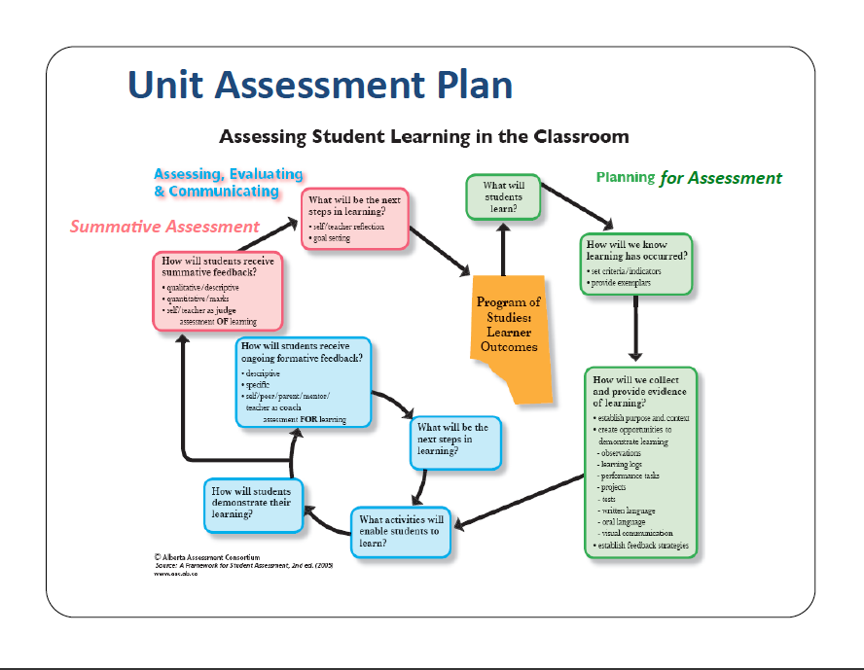
Unit Planning Discussion

Slide 116

Quick-Write Question(s):
Teachers are sometimes the “Sage on the Stage” and sometimes they are the “Guide on the Side.”
  What does this mean to you?

Slide 117
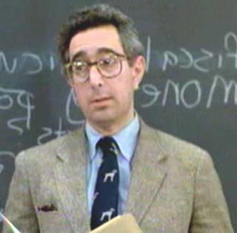
Presenting New Material
(Direct Instruction -Step 3)
Deductive
Inductive
Deductive reasoning arrives at a specific conclusion based on generalizations.
Teacher helps students move from examples to definition of the concept
Inductive reasoning takes events and makes generalizations
Teacher defines the concept and provides examples
Gunter, M. A., Estes, T. H., & Mintz, S.L. (2007). Instruction:
A models approach. Boston: Pearson Education.

Slide 118
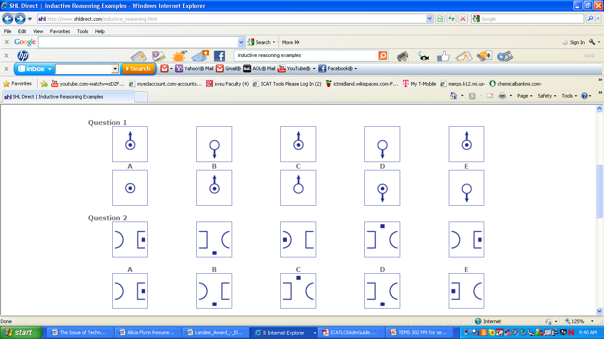
Inductive Reasoning (Parts to Whole) Examples

Slide 119
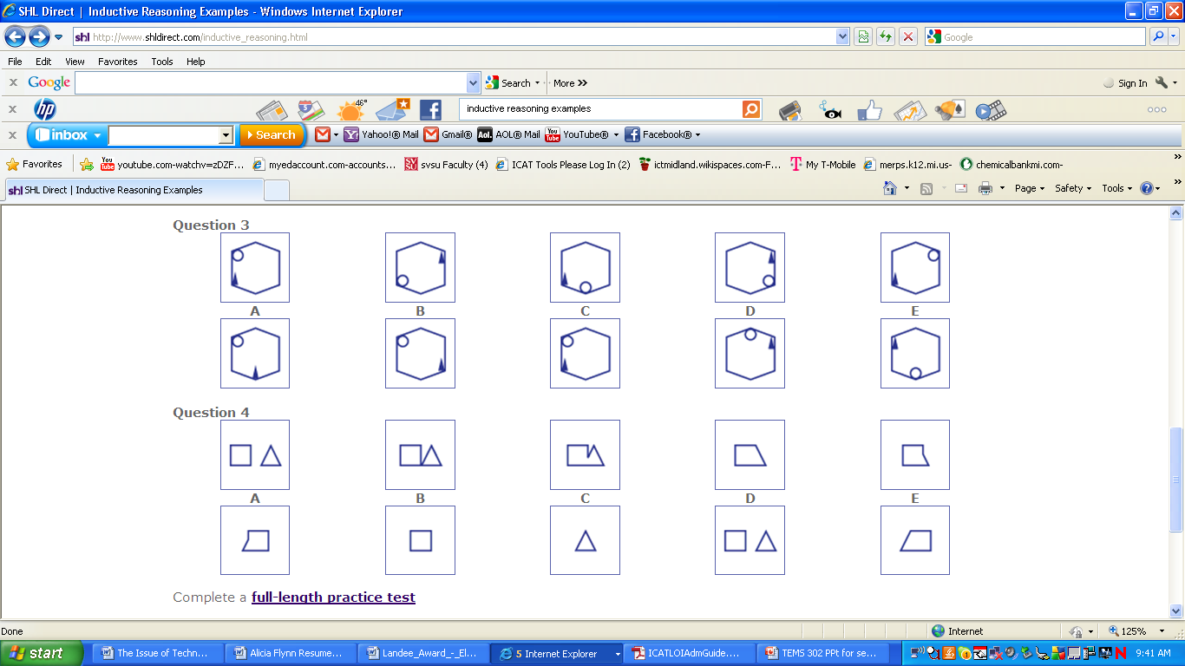
Inductive Reasoning (Parts to Whole) Examples

Slide 120
Deductive Reasoning (Whole to Parts) Examples
All oranges are fruits
All fruits grow on trees
Therefore, all oranges grow on trees
All bachelor's are single
Johnny is single,
Hence, Johnny is a bachelor

Slide 121






Take 2 minutes to create a Deductive Reasoning Example

Slide 122

Marketplace Laws & Reality
Sadker, D. S., & Zittleman, K. R. (2009). Teachers, schools, and society: A brief introduction into education.
2nd Edition. New York: McGraw Hill.

Slide 123
Dr. Jonathon A. Gould → JAGould@SVSU.Edu
I wish to thank each and every one of you, for YOU are the reason this Professional Development was both magical and meaningful! I wish you success this school year ☺

